Slide 1

Phase 4 Presentation

Slide 2
A Reminder of Dollar Doodle
This is an innovative personal finance tracker that:
Helps users keep track of their spending.
Scan in receipts to make inputting transactions quicker.
Give AI suggestions to help the user improve their financial habits.
Notes:
Alex

Slide 3
Overview
1
2
3
4
Improvements and additions
Demonstration
If additional time had been available ...
Conclusion
Notes:
Alex

Slide 4
Improvements
Browser messages are now in app messages.
The receipt scanner categorizing is better(not perfect).
Made minor CSS changes .
Filters are used to narrow down transactions by displaying only the information with specific criteria.
Pagination: used to divide the table of transactions to improve readability and navigation.
Notes:
Nick

Slide 5
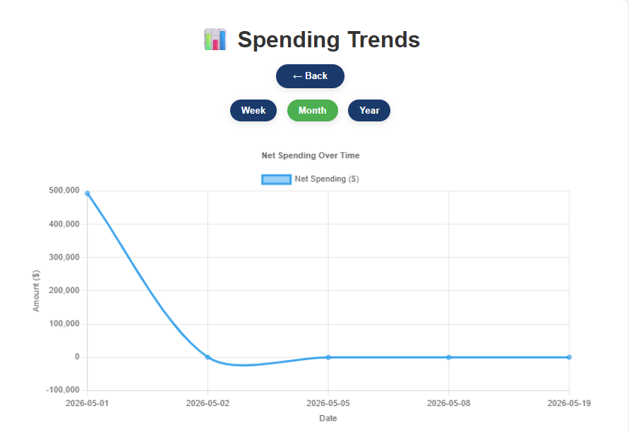
New feature: Graphs!
Made using ChartJS.
Based off user incomes and expenses.
Gives the users good visualization and easy understanding of their finances.
Notes:
Daniel

Slide 6
We will demonstrate
 | Description
📷 Receipt Upload | Scan receipts with Veryfi OCR.
💰 Expense Tracking | Manual or automatic transaction entry.
🤖 AI Insights | Smart spending analysis and suggestions.
✏️ Edit Transactions | Update expenses and incomes anytime.
📊 Dashboard | View balance and transaction history with pagination and filters
📈Graphs | Visuals for the users.
Notes:
Roma

Slide 7

If additional time had been available ...
Enhance the graphs to give betters visuals and apply filters.
Perfect the receipt scanner categorization.
Create a budgets page so a user could set a desired budget.
Mass deletes for selected transactions
Notes:
Roma

Slide 8
Lessons learned
AI inaccuracy issues:
Do not blindly trust AI.
Check over the code it gives you.
Veryfi categories:
Could not get it to categorize.
Mapped to Veryfi given categories.
Testing:
There is a lot of situations to test.
Having multiple accounts with different amount of data helps.
Notes:
Alex

Slide 9
Conclusion
Dollar Doodle is more than just a regular personal finance application:
We use AI insights to help the users make better financial decisions.
User friendly interface allows for easy use of the application.
Many features that we covered that makes it easier to use.
Notes:
Alex

Slide 10
Team Responsibilities
Alex Hildreth
Project Manager
Nick Schott
Daniel Austin
Front End Development
Roumaysae Jerari
Eva Buesse
Back End Development
Contact Us: dollardoodledev@gmail.com
Notes:
Alex

